Slide 1
AngularJS: Basics
Demonstrating how to use the essential abstractions of AngularJS, including modules, controllers, directives, services and routes.

Slide 2
Agenda
An Introduction
Controllers
Directives and Views
Services
Routing

Slide 3
What is AngularJS
AngularJS is a JavaScript MVC framework created by Google to build properly architectured and maintainable web applications.
It’s not a JavaScript library (As they say). There are no functions which we can directly call and use.
It is not a DOM manipulation library like jQuery. But it uses subset of jQuery for DOM manipulation (called jqLite).
Focus more on HTML side of web apps.
For MVC/MVVM design pattern

Slide 4
Why AngularJS
Defines numerous ways to organize web application at client side.
Enhances HTML by attaching directives, custom tags, attributes, expressions, templates within HTML.
Encourage TDD
Encourage MVC/MVVM design pattern
Code Reuse
Good for Single Page Apps (SPA)

Slide 5
Single Page Application (SPA)
SPA Demo
http://www.myspa.com
View
View
View
View

Slide 6

The Challenge with SPAs
DOM Manipulation History Module Loading
Routing Caching Object Modeling
Data Binding Ajax/Promises View Loading

Slide 7

Data Binding
MVC
Routing
Testing
jqLite
Templates
History
Factories
ngularJS is a full-featured SPA framework
ViewModel
Controllers
Views
Directives
Controllers
Dependency Injection
Validation

Slide 8
Key features of AngularJS
Declarative HTML approach
Easy Data Binding : Two way Data Binding
Reusable Components
MVC/MVVM Design Pattern
Dependency Injection
End to end Integration Testing / Unit Testing
Routing
Templating

Slide 9
Key features of AngularJS
Modules
Services
Expressions
Filters
Directives
Form Validation

Slide 10

Transclusion
?
Restriction
Scope
Directive
Linking

Slide 11



Slide 12


Slide 13
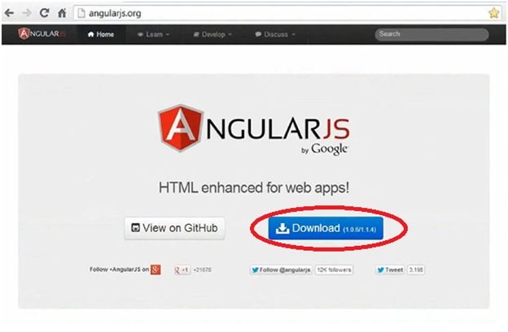
Home page

Slide 14
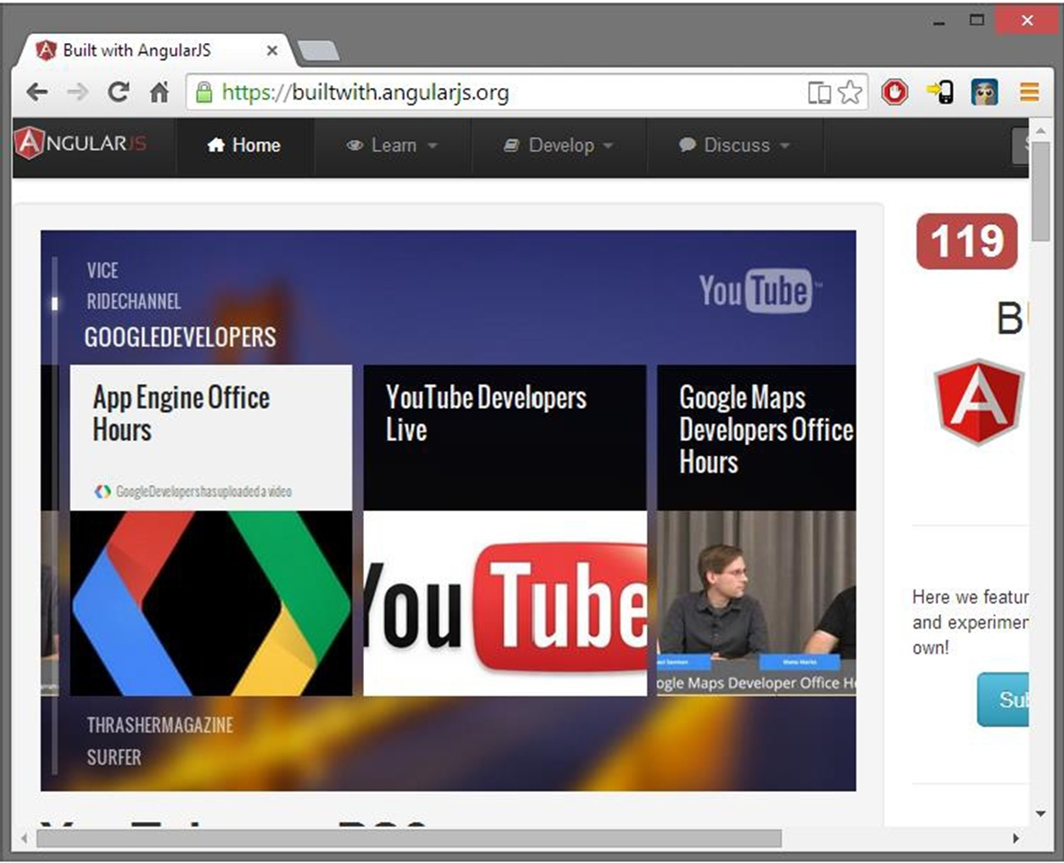
Built with

Slide 15
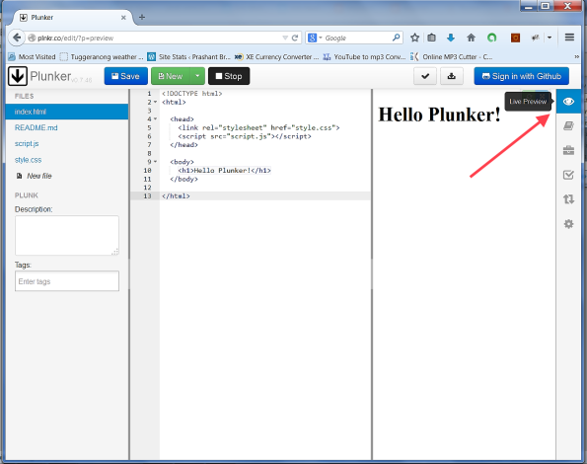
Using Plunker

Slide 16
Two Requirements
Add a <script> tag pointing to angular.js file.
Add an ng-app attribute in your HTML
ng-app is an Angular directive
The ng is short of Angular
Use this directive to auto-bootstrap an application.
Only one ng-app directive can be used per HTML document
<html ng-app>

Slide 17

Demo 1

Slide 18
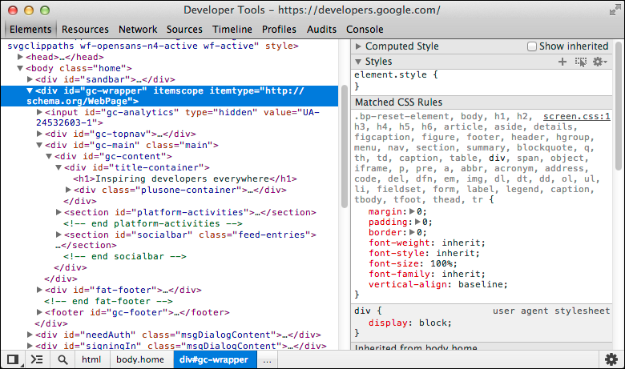
Developer tools

Slide 19
JavaScript Patterns
Functions as abstractions - provide encapsulation to make other code easier to write
Function to build modules (revealing module pattern - RMP)
Functions to avoid global variables
Immediately invoked function expression(IIFE)

Slide 20
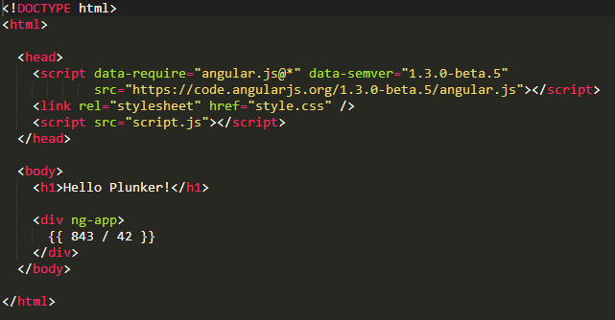
Summary

Slide 21

Controllers

Slide 22
Controller Basics
Controller directive in HTML (ng-controller)
Controller will be a function that Angular invokes
Controller takes a $scope parameter
Attach model to $scope

Slide 23
Demo 2

Slide 24
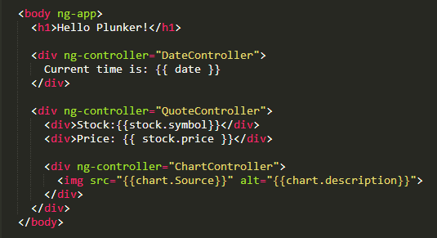
Controller Capabilities
Multiple controllers
Complex objects
Nest controllers

Slide 25
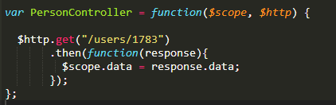
$http Service
Encapsulates HTTP communication
GET, POST, PUT, DELETE
Can “ask” for $http inside a controller
Just add as another parameter to controller function
Always returns a promise
A promise to deliver a value in the future

Slide 26
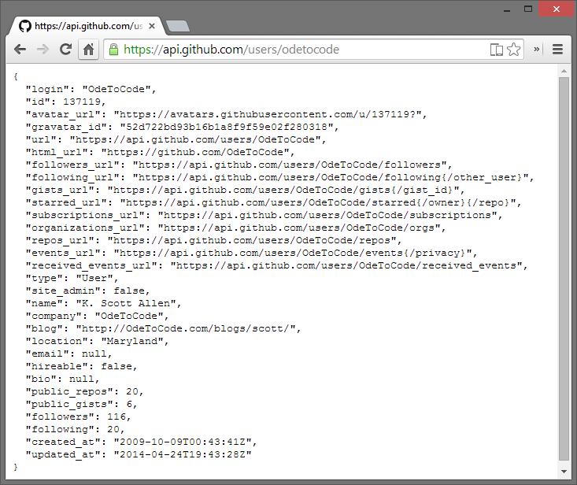
GitHub API
Available from JavaScript in a browser
Returns JSON (easy to convert into objects)
No authentication or client key required

Slide 27
Demo 3

Slide 28
Controllers and Modules
Controllers usually live in modules
Avoids the global namespace
Working with modules
Create a module with a name
Register your controllers in the module
Tell Angular to use your module with ng-app

Slide 29
Modules are containers
Module
Config
Routes
View
$scope
Controller
Directives
*Factory

Slide 30
Creating a Module
What's the Array for?
var demoApp = angular.module('demoApp', []);
var demoApp = angular.module('demoApp',
['helperModule']);
Module that demoApp depends on

Slide 31
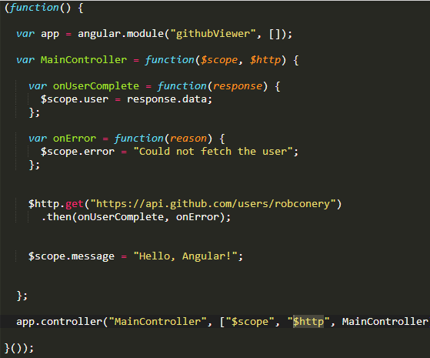
Controllers: Summary
Controllers manipulate
Scope
Controllers can live in a
Module
Controllers can use
services like $http

Slide 32
Directives and Views

Slide 33
Directives
$scope provides the model
Model does not touch HTML
Data binding moves model
data to view {{ }}
Directives allow for indirect
model view interaction

Slide 34
Directives
Can be placed in element names, attributes, class names, as well as comments. Directives are a way to teach HTML new tricks.
A directive is just a function which executes when the compiler encounters it in the DOM.
<input ng-model='name'>
Custom Defined Directives
<span draggable>Drag ME</span>

Slide 35
Demo 4

Slide 36
Using Directives and Data Bindings
<!DOCTYPE html>
<html ng-app>
<head>
<title></title>
</head>
<body>
<div class="container">
Name: <input type="text" ng-model="name" /> {{ name }}
</div>
<script src="Scripts/angular.js"></script>
</body>
</html>

Slide 37
Expression
Expressions are JavaScript-like code snippets that are usually placed in bindings such as {{ expression }}
<body>
1+2={{1+2}}
</body>

Slide 38
Filters
Basic format: expression | filter: parameter
Name
currency | {{ amount | currency: ‘USD$’ }}
date | {{ startDate | date: ‘short’ }}
filter | repo in repos | filter: searchTerm
json | {{ repo | json }}
limitTo | repo in repos | limitTo:10
lowercase, uppercase | {{ user.name | uppercase }}
number | {{ stars | number }}
orderBy | repo in repos | filter: searchTerm | orderBy:’name’

Slide 39
Using Filters
<ul>
<li data-ng-repeat="cust in customers | orderBy:'name'"> {{ cust.name | uppercase }} </li>
</ul>
<input type="text" data-ng-model="nameText" />
<ul>
<li data-ng-repeat="cust in customers | filter:nameText | orderBy:'name'"> {{ cust.name }} - {{ cust.city }}</li>
</ul>

Slide 40
Built-in Directives
ng-app | ng-bind | ng-blur | ng-change
ng-class | ng-click | ng-copy | ng-dblclick
ng-disabled | ng-focus | ng-hide | ng-href
ng-if | ng-include | ng-init | ng-keydown
ng-keypress | ng-keyup | ng-model | ng-mouseenter
ng-mouseleave | ng-mousemove | ng-mouseover | ng-paste
ng-repeat | ng-style | ng-switch | ng-transclude

Slide 41
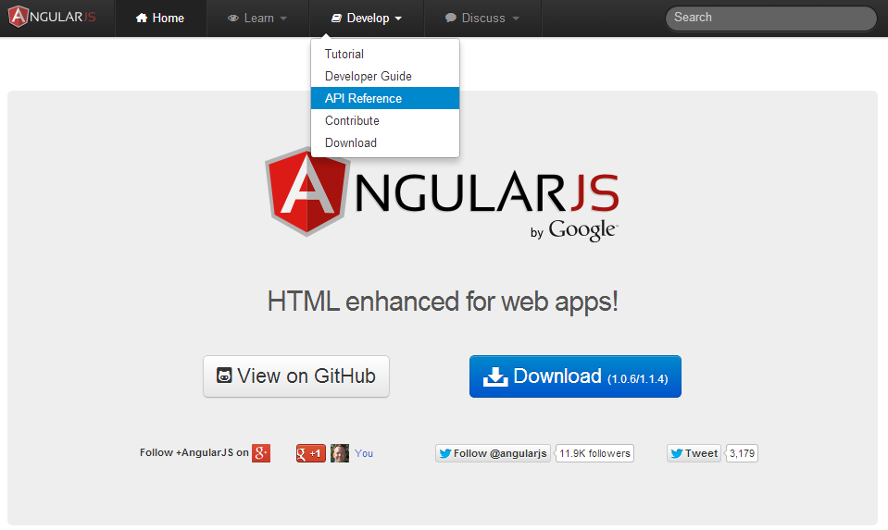
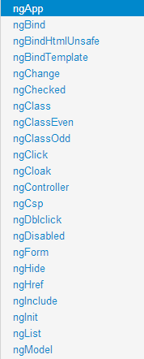
Angular Help for Directives

Slide 42
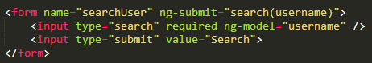
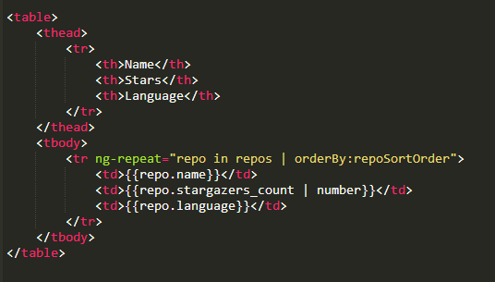
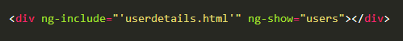
Conclusion
Binding directives
Model directives
Event directives
Display directives

Slide 43
Services

Slide 44
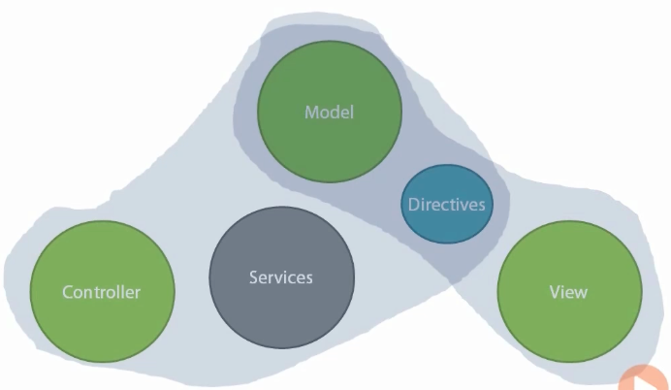
Where do Services fit?

Slide 45
The Role of Services
$window
$http
$browser
Controller
$interval
$location
$timeout
$animate
$log

Slide 46
UI Related Services
VIEW
$browser
$window
Controller
$location
$anchor
Scroll
$animate

Slide 47
Services
So far
Controllers setup the model
View consumes the model
Directives are an intermediary

Slide 48
Why build your own?
Create reusable logic
Create shared data
Manage complexity

Slide 49
Demo

Slide 50
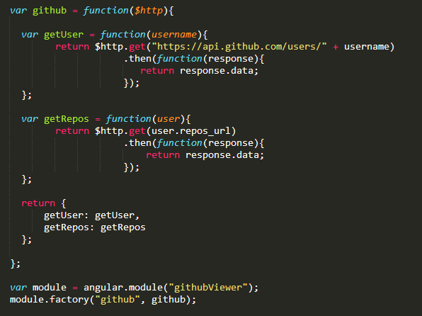
Services: Summary
Services as a barrier
Services as components
Services for custom logic

Slide 51
Routing

Slide 52
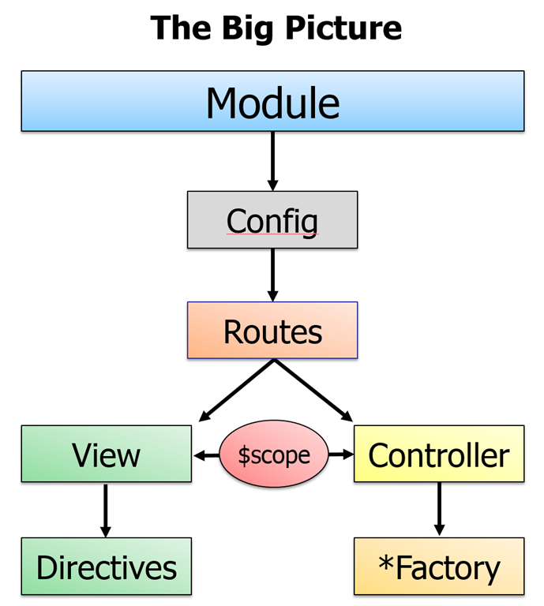
Routing
Routing based on url
Routing rules render a response
Routing engine captures
requests

Slide 53
Routing with Angular
Depends on another module: angular-route.js
Configure rules into $routeProvider
Setup a layout view
User.html
layout
ng-view
Repo.html

Slide 54
main.html
(search user)
index.html
(shell)
user.html
(user details)
repo.html
(repository details)

Slide 55
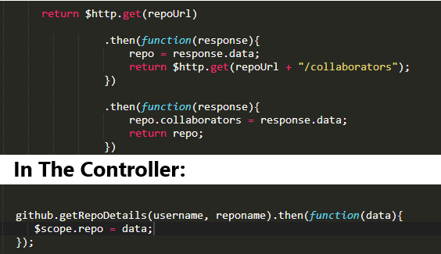
Chained promises
Each return is the input to the next success function

Slide 56
The End is the Beginning
Angular.js – a framework for building HTML applications
Controllers
Models
Views
Services
Routing
Navigation
Smaller pieces

